Slide 1
Workshop: Web Apps w/ Flask
Hacknight #2!

Slide 2
Quick Intro to Hack Nights
ACM Programming Club x KUBI
KU Blockchain & ACM Programming Club are joining forces this semester!
This week’s Hack Night is hosted by ACM Programming Club
Hack Nights are for learning and collaboration
These events will be every Thursday & we will host alternating weeks
Pizza next week
Open to everyone, so bring your friends!
Notes:
DYLAN

Slide 3

ACM
Student-led club with the directive of education and collaboration in the field of computer science
Meetings - Wednesdays@6PM in LEEP2 G415
Scan here to join our Discord!
Notes:
DYLAN

Slide 4

KU Blockchain Institute (KUBI)
Student-led research initiative promoting education, research, & development with blockchain technology
Primary meetings - Tuesdays @6PM in Learned 3152
Scan here or come back next week to learn more!
Notes:
KUBI

Slide 5

Topics Covered
01
02
03
04
What is Flask?
Why use Flask?
Using Flask
Flask - Getting Started
Notes:
Dellie
Flask is a web framework, it’s a Python module that lets you develop web applications easily. It’s has a small and easy-to-extend core: it’s a microframework that doesn’t include an ORM (Object Relational Manager) or such features.
Unlike the Django framework, Flask is very Pythonic. It’s easy to get started with Flask, because it doesn’t have a huge learning curve.
https://flask.palletsprojects.com/en/2.3.x/quickstart/
balls

Slide 6
What is Flask?
Flask is a python module and Web Application Framework
Flask lets you develop web applications easily
Built in python
Easy-to-extend
Notes:
Dellie
Web Application Framework: collection of libraries and modules that enable web application developers to write applications without worrying about things like protocol, thread management, etc.
Flask is built in, and for python
flask is easily scalable

Slide 7
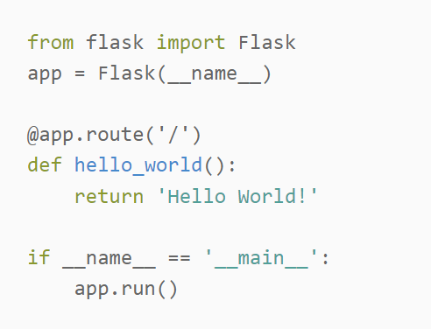
Why use Flask?
Flask is simple to install and use
It’s written in Python!!!!!
It is literally that easy ---->
Easily extendable
Connect Python to HTML files!
Notes:
DYLAN

Slide 8
Getting Started
`pip install flask`
create a file: `flaskApp.py`
add this code ---->
‘python flaskApp.py’
you’re done!
Notes:
Dellie
Installing flask is pretty easy, you use pip to install it with the first command
To start developing with it, create a python file and add the code to the right
walk through line-by-line
to run this, do python flaskapp.py

Slide 9
Using Flask
Using HTML Templates and CSS
Integrating Python code and variables in HTML Templates
Handling routing and subdirectories EX: (google.com/images)
Notes:
DYLAN

Slide 10
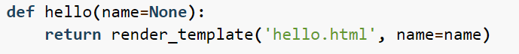
HTML Templates and CSS
Templates allow for integration of Python data into HTML
Uses the Jinja2 template engine!
Notes:
DYLAN

Slide 11
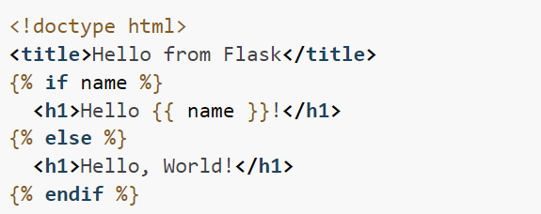
Putting Python into Templates
You can also add python into your HTML files using {{}} and {%%}
Notes:
DELLIES
another way to interact with html with python is through jinja2
Jinja2 is a Python templating engine used in Flask to insert dynamic content, variables, and logic into HTML templates for web application rendering.
here, it is shown creating an if statement

Slide 12
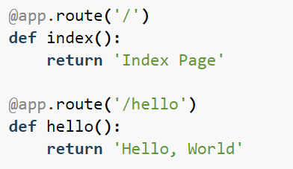
Routing/Subdirectories
Subdirectories with Flask work by changing the route function’s parameter.
Notes:
DELLIE

Slide 13
Help Us!
Let’s set up a basic web app!
Help us out!!
https://github.com/delster1/bugSmashers
Notes:
Present until the “Help Us!” slide
Open premade repo
https://github.com/delster1/bugSmashers/tree/main
NOTE: THERE WILL BE MULTIPLE EXAMPLE FILES
EXAMPLE 1: Making a basic first web app
Present on board
EXAMPLE 2: Slightly more advanced Flask usages
Present separately
Resources for serving static files (FIRST ONE BETTER STRUCTURALLY):
https://flask.palletsprojects.com/en/2.3.x/quickstart/#static-files
https://github.com/Birduo/inthua/blob/main/inthua.py

Slide 14
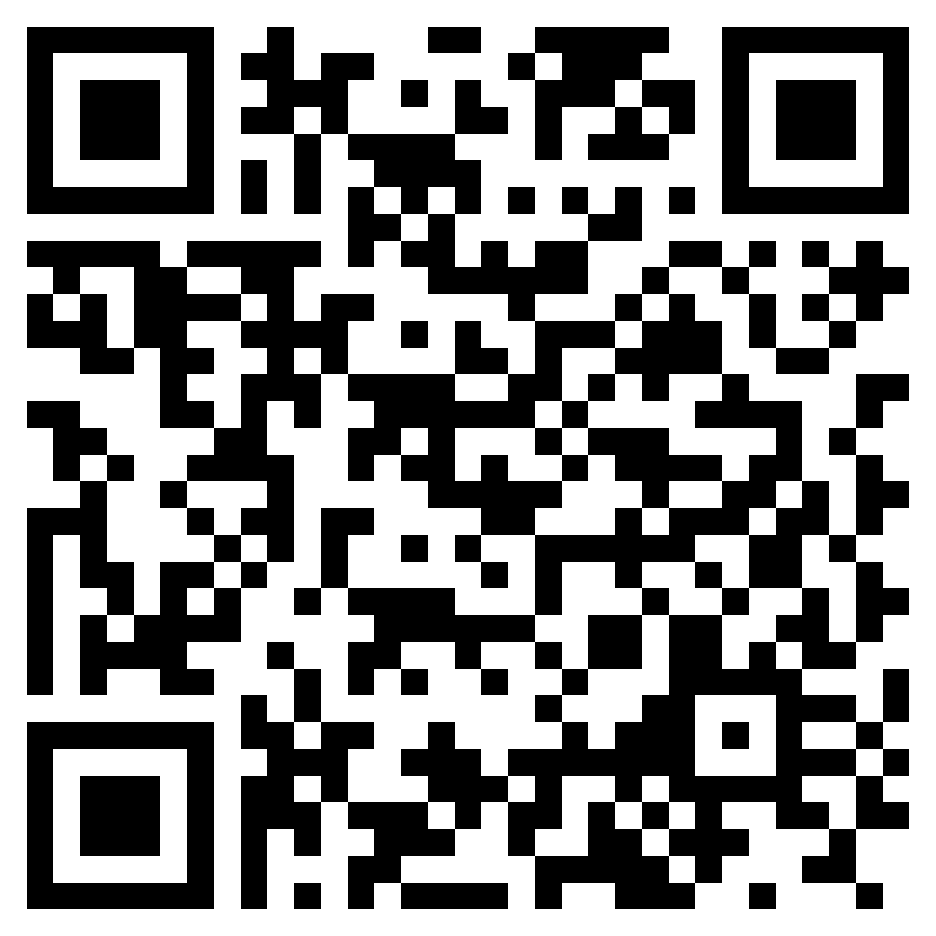
Resources
Flask Quickstart https://flask.palletsprojects.com/en/2.3.x/quickstart/
Notes:
https://www.tutorialspoint.com/flask/index.htm

